Slide 1

How to Fix an Inherited Report
A Toolbelt for Dissecting, Triaging, and Rebuilding the Report Nobody Wants to Touch
Kristyna Ferris
Fun Fact: this font is dyslexic friendly! Ask me how to use it for free after the session.
Notes:
Top 10 Dyslexia-Friendly Fonts for 2026 | TypeSmith | TypeSmith
Download the font from Atkinson Hyperlegible - Google Fonts
Extract the files
Go to computer settings > personalization > fonts and drop in the files
Navigate to Power Point Master Slide
Change the font to use Open Dyslexic for the headers and body
Done!

Slide 2

About Me ~ Kristyna Ferris
Microsoft MVP, Data Platform & Fabric
Solution Architect, P3 Adaptive
Lexington Data Tech Group co-organizer
DataOnWheels Author
Blog
https://dataonwheels.wordpress.com/
LinkedIn
https://www.linkedin.com/in/kristyna-ferris-dataonwheels/
Twitter & Bluesky
@data_dragoness

Slide 3

The Big Break
“Hey, we have this report the previous VP used. It’s really slow, and the new VP wants it revamped to answer their questions.”
Great, you think. I can knock this out, no problem!
More facetime = more visibility = more opportunities.

Slide 4
Then You Open the Report…
50
100+
6
tables
measures
calculated tables
Zero documentation. The person who built it left two years ago.

Slide 5
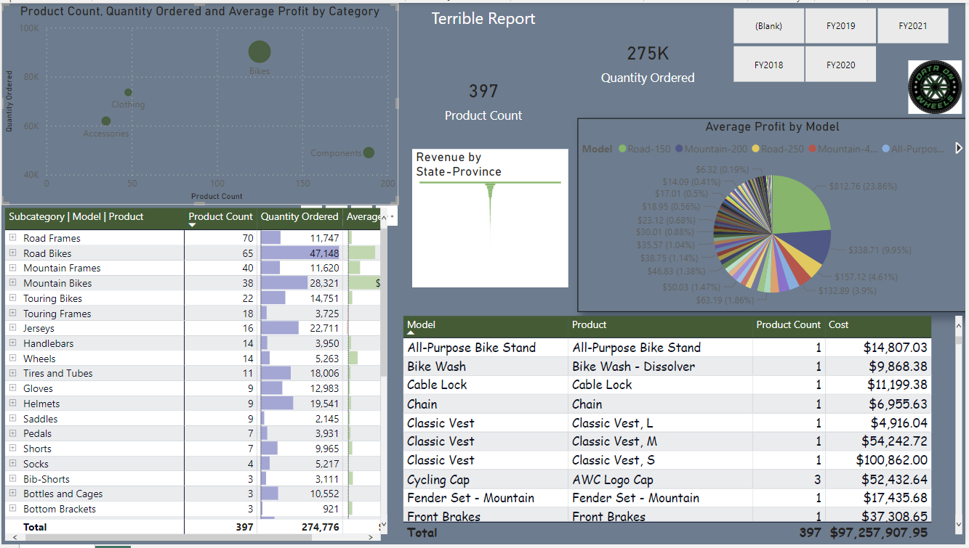

Slide 6

PANIC
Who made this hot pile of garbage?
And who’s been using it?
How can I make this something beautiful in any sort of reasonable amount of time?
Will THIS be my legacy?

Slide 7



Take a Breath: Three Phases
PHASE 1
PHASE 2
PHASE 3
INSPECT
ARCHITECT
BUILD
Know what you inherited before you touch it
→
Design the target and grab the quick wins
→
Rebuild it right, with AI as a helper
Save a safe copy
Interview stakeholders
Dissect the code with AI
Share feedback with AI
Quick-win checklist
Visual best practices
Model best practices
AI rebuild guardrails
Verify the numbers
Tools for the job
Notes:
No need to panic. Every inherited report rebuild moves through the same three phases: inspect what you have, architect what it should be, then build it. AI helps in all three.

Slide 8

Practical First Steps
INSPECT
1
Save a copy before changing anything.
2
Meet with stakeholders to learn what works and what doesn’t. The goal is trust.
3
Break it down into manageable tasks.
4
Define “done” together to avoid a development spiral.
5
Accept that some things you cannot fix.

Slide 9
Meeting with the Stakeholders
INSPECT
Be nosy. Ask TONS of questions.
What decisions will this data drive?
What dimensions give context to the metrics?
What are the “make more money” metrics that matter most?
Where does the data live today?
What grain and scope does the data need?
Are there data quality landmines waiting to explode?
Who uses this report, and how do they slice it?
How often do these questions need answering?

Slide 10
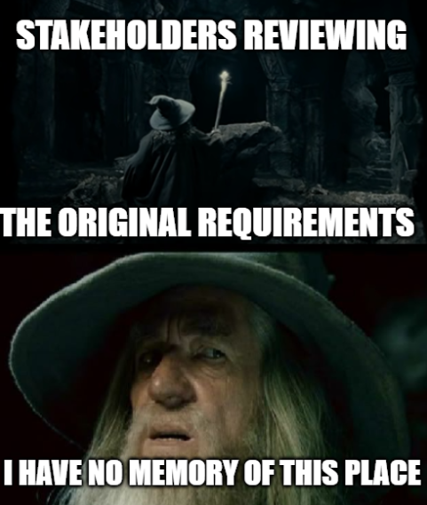
Pro Tip: Hold Them Accountable
INSPECT
Write the answers down and email them to the stakeholders.
It creates a paper trail for when scope creep shows up uninvited.
Even better: put the answers on a hidden page in the report itself.
The purpose of the report travels with the report.

Slide 11
Dissect the Code with AI
INSPECT
Let AI read all fifty tables so you don’t have to. Then verify what it tells you.
1
2
3
4
Save as PBIP
→
Point AI at it
→
Ask for an inventory
→
Verify
Model and report become readable text files
Open the project folder in Claude Code
Tables, measures, calc tables, and where each is used
Cross-check with Measure Killer before you delete
Notes:
Save the PBIX as a Power BI Project (File > Save as > .pbip). The semantic model becomes TMDL text files and the report becomes PBIR JSON, which AI can read directly. Open the folder in Claude Code and ask for an inventory. Then confirm anything you plan to delete with Measure Killer.

Slide 12




Prompts I Actually Use
INSPECT
Inventory
Dead weight
List every table, measure, and calculated table, and which visuals use each one.
Which measures and columns aren’t used by any visual or other measure?
Translate
Red flags
Explain this measure in plain English and flag anything that looks wrong.
Find bidirectional and many-to-many relationships, auto date tables, and calculated tables.
AI reads the files. You own the answers.

Slide 13

What’s Working, What’s Not
INSPECT
Meeting transcript
KEEP
FIX
CUT
Fiscal year filter
Subcategory → Model → Product table
Quantity Ordered
“Profit Margin” is dollars, not %
State funnel → revenue by territory
Blank fiscal year
40-slice pie chart
Scatter chart
Cost table nobody can tie out
Your notes and requirements
→
The PBIP code
Prompt: “Here’s the stakeholder transcript and the PBIP. Sort every visual and measure into keep, fix, or cut, and quote who said so.”
Notes:
AI can read the code, but it cannot know which visuals people love and which ones they ignore. Give it the stakeholder meeting transcript or your notes along with the code. Ask it to sort every visual and measure into keep, fix, or cut, and to quote who said so. The examples here come from the simulated stakeholder transcript for the Terrible Report. Check its sorting against your own notes before you act on it.

Slide 14

Demo time!
INSPECT
Save the report as a PBIP
Dissect the code with AI
Feed AI the stakeholder transcript
Unused objects with Measure Killer

Slide 15

Quick Wins Checklist
ARCHITECT
Model
Report
Remove unused tables and columns
Run Performance Analyzer to find the slowest visuals
Turn off Auto date/time
Cut each page to 6–10 insights
Move calculated tables to Power Query or upstream
Swap pies and donuts for bars
Fix bidirectional and many-to-many relationships
Delete hidden and unused pages and visuals
Split high-cardinality datetime columns
Use explicit measures, not implicit aggregations
Notes:
These are the changes that usually pay off in the first day or two, before any real redesign. Run Performance Analyzer first so you know which visuals are actually slow.

Slide 16
Visual Best Practices
ARCHITECT
It’s all about TRUST
About 6–10 insights per page
Choose the right visual for the job
Include trending visuals
Group related metrics
Size visuals to be readable
Use a consistent color palette
Add clear headings and labels
Round numbers where it helps
Lay it out to read top to bottom, left to right, like a newspaper
Reference: numerro.io, The Complete Guide to Designing Power BI Reports (link in notes)
Notes:
Super useful reference: https://www.numerro.io/guides/the-complete-guide-to-designing-power-bi-reports

Slide 17
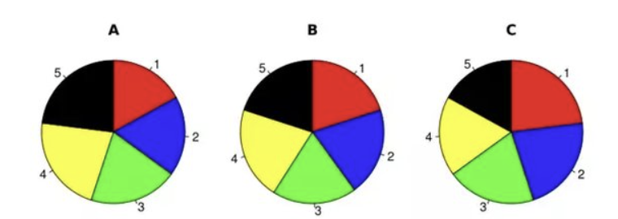
Rank These Slices, Biggest First
ARCHITECT
Notes:
Pies and donuts are better desserts than visuals.

Slide 18
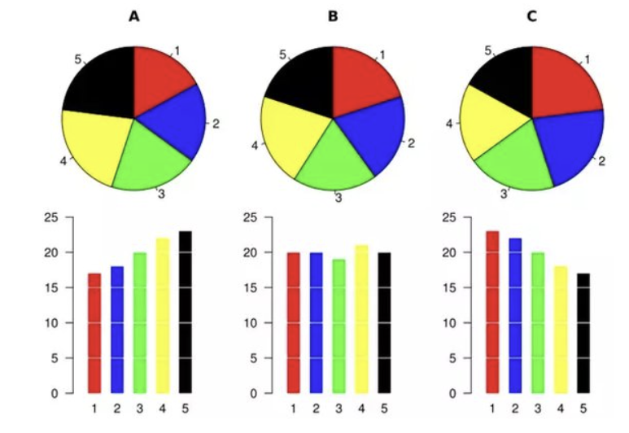
How Many Did You Get Right?
ARCHITECT
A
5, 4, 3, 2, 1
B
4, 5/2/1, 3
C
1, 2, 3, 4, 5
Notes:
Pies and donuts are better desserts than visuals.

Slide 19
Model Best Practices
ARCHITECT
1
Every column and table feeds a visual or metric
5
Relationships flow the right direction on the right fields
2
STAR SCHEMA ALL THE THINGS
6
Organize the modeling view
3
No many-to-many relationships (rare exceptions)
7
House metrics in a measures table or folders
4
Metrics are tested and trusted by stakeholders
8
Know when to build from scratch

Slide 20
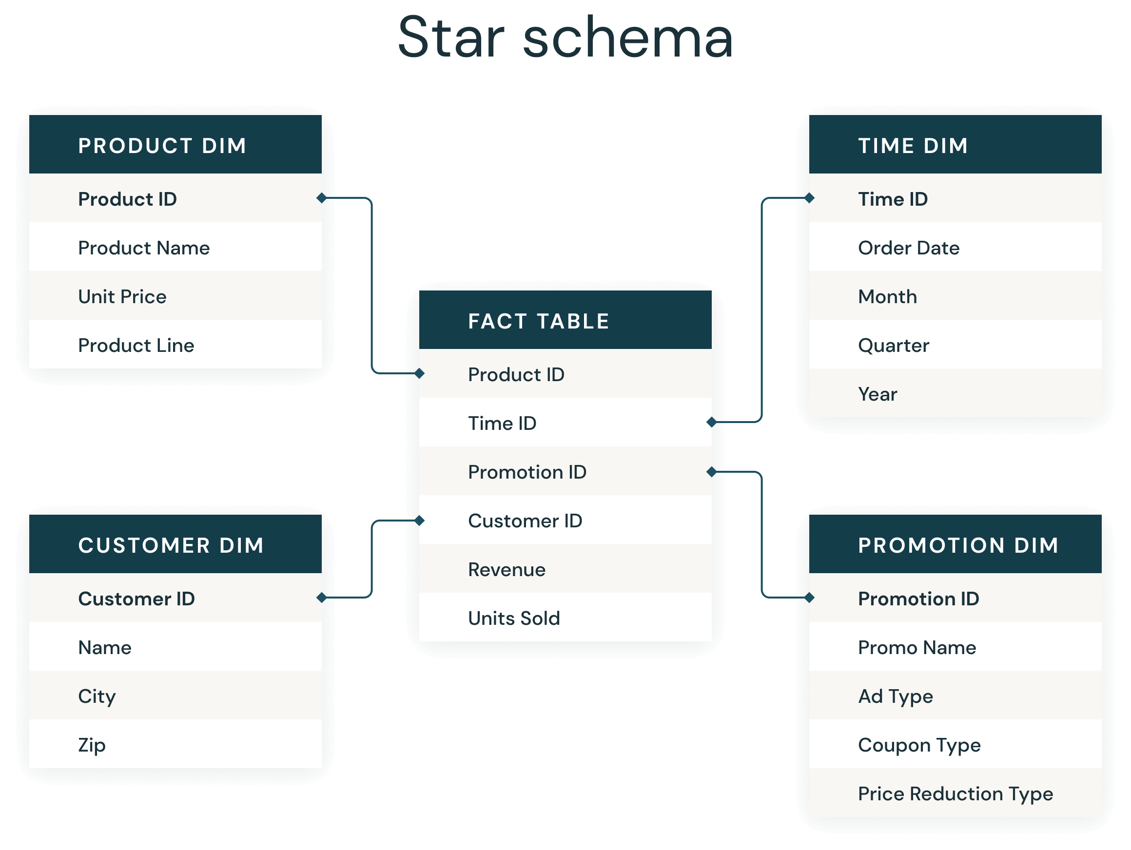
Star Schema, It’s Important
ARCHITECT
A proven design pattern for analytics.
Fact tables hold the numbers: sales, revenue, inventory.
Dimension tables give context: who, what, when, where.
Built for the VertiPaq engine: fewer tables, faster queries.
Unlocks slicers, hierarchies, and time intelligence out of the box.

Slide 21
Rebuild with AI, Safely
BUILD
AI is a fast junior developer. Give it rules, small tasks, and a reviewer.
1
Work on a copy, never on live
PBIP in a git repo, so every change is a diff you can review
2
Give AI your rules
A CLAUDE.md with your star schema, naming, and DAX standards
3
Small batches
One table, measure group, or page at a time, then reopen in Desktop
4
You approve every change
AI drafts. You decide what ships.
Notes:
A CLAUDE.md file (or rules file for whatever AI tool you use) holds your standards: star schema, naming conventions, DAX patterns, and things it must never do, such as editing the live copy. The AI reads it at the start of every session.

Slide 22



Trust, but Verify the Numbers
BUILD
If the new report doesn’t match the old one, nobody will trust either of them.
Snapshot the old
Rerun on the new
Diff and explain
Run a DAX query of key measures by key dimensions against the original report
Same query, same filters, against the rebuilt model
Every difference is either a fix you can explain or a bug
Notes:
Write a DAX query (EVALUATE SUMMARIZECOLUMNS) that returns your key measures by your key dimensions. Run it against the original report and save the result. Run the same query against the rebuilt model and compare. AI is great at writing these queries and at diffing the results.

Slide 23




Tools for the Job
BUILD
AI (Claude Code)
Measure Killer
Reads PBIP files, inventories the model, and drafts changes to your standards
Used vs. unused objects, lineage, and a best practice analysis
DAX Studio
Tabular Editor
See how queries execute in the engine and time them
Script model changes and run Best Practice Analyzer rules
All of these have free versions. Links are in the slide notes.
Notes:
Claude Code: https://claude.com/claude-code
Measure Killer | Brunner BI: https://en.brunner.bi/measurekiller
DAX Studio: https://daxstudio.org
Tabular Editor: https://tabulareditor.com

Slide 24
Helpful MCP Servers
BUILD
Power BI Authoring
Fabric IQ
Microsoft Learn
Microsoft · Local is GA
Microsoft · GA
Microsoft · Free
Edit models in Desktop, PBIP, or Fabric and run DAX. Has a read-only mode.
Find reports and query models, read only. Security still applies.
Search the docs and code samples. No sign-in needed.
DAX Formatter
Tabular Editor 3
Fabric MCP Server
SQLBI · Free
Tabular Editor · Paid
Microsoft · Open source
Format and syntax-check the DAX that AI writes.
Agent edits the open model. Review or undo before saving.
Fabric API docs, best practices, and OneLake files.
Start read-only. Let the agent look before you let it touch.
Notes:
MCP (Model Context Protocol) servers give an AI agent tools: here, the ability to read and edit semantic models, run DAX, and look up docs.
Power BI Authoring MCP (local, GA): https://github.com/microsoft/powerbi-modeling-mcp and https://learn.microsoft.com/en-us/power-bi/developer/mcp/power-bi-authoring-mcp. Do not register the local and hosted versions at the same time.
Fabric IQ MCP (GA, replaces the older Power BI remote MCP): https://learn.microsoft.com/en-us/fabric/iq/connectors/fabric-iq-mcp
Microsoft Learn MCP: https://learn.microsoft.com/en-us/training/support/mcp
DAX Formatter MCP (SQLBI): https://docs.sqlbi.com/dax-formatter/mcp-stdio
Tabular Editor 3 MCP (needs a TE3 license): https://docs.tabulareditor.com/en/features/mcp-server.html
Fabric MCP Server (open source): https://github.com/microsoft/mcp/tree/main/servers/Fabric.Mcp.Server
Status checked 11.5.26.

Slide 25

Demo time!
BUILD
Drop unused measures and calculated tables
Reconnect visuals to the star schema
Compare the numbers and the speed, before and after

Slide 26
Key Takeaways
1
Inspect: know what you inherited and why it exists before you touch it
2
Architect: grab the quick wins first; they buy you trust and time
3
Build: let AI do the reading and drafting; you own the decisions
4
Verify the numbers, or nobody will trust the rebuild

Slide 27

Don’t forget to connect, thanks for listening!
https://dataonwheels.wordpress.com/
kristyna@dataonwheels.com
@data_dragoness
GitHub

